Slide 1
EduSync Pro - AKGEC CollegeERP
Aradhya Priyadarshi 2000270110021
B. Tech IT – 2
Ajay Kumar Garg Engineering College, Ghaziabad

Slide 2
Contents
Objective Of The Project
Problem Domain
Project Snapshots
Requirement Specification
CollegeERP
Project Link
Summer Training Certificate

Slide 3
Objective Of The Project
The objective of EduSync Pro – AKGEC CollegeERP is to allow the administrator of any organization the ability to edit and out the personal details of a student and allows the student to keep up to date. It'll also facilitate keeping all the records of students, such as their id, name, mailing address, phone number, DOB etc. So all the information about a student will be available in a few seconds. Overall, it'll make Student Information an easier job for the administrator and the student of any organization.

Slide 4
Introduction To The Problem Domain
As we know that, a college consists of departments, such as course departments, fees management, library, event management etc. Nowadays applications and uses of information technologies is increased as compared to before, each of these individual departments has its own computer system to do their own functionalities. By having one main system they can interact with each other from their respected system by having valid user id and password.

Slide 5


Operating Environment
The following system requirements are needed in order to run CollegeERP successfully in a system.
OS: Windows 11
Database: MySQL database
Frontend: HTML/CSS/Bootstrap
Backend: Python / Django Framework

Slide 6

Django
Django is a high-level Python web framework that encourages rapid development and clean, pragmatic design. Built by experienced developers, it takes care of much of the hassle of web development, so you can focus on writing your app without needing to reinvent the wheel. It’s free and open source.

Slide 7
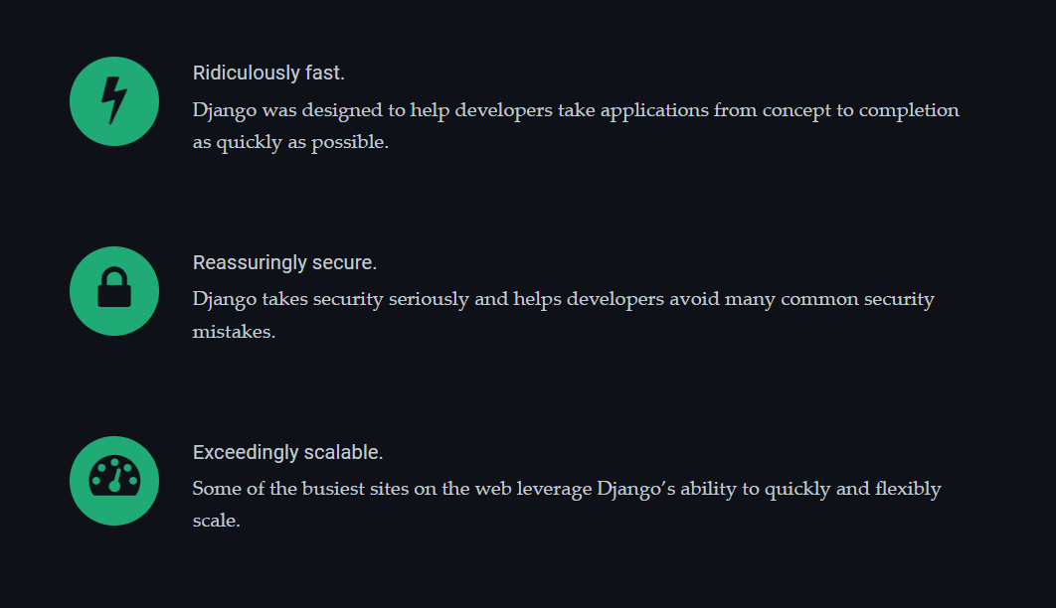

Slide 8
How does Django Work?
Django follows the MVT design pattern (Model View Template).
Model - The data you want to present, usually data from a database.
View - A request handler that returns the relevant template and content - based on the request from the user.
Template - A text file (like an HTML file) containing the layout of the web page, with logic on how to display the data.

Slide 9



Identification of Stakeholders
Students
Teachers
Admin

Slide 10
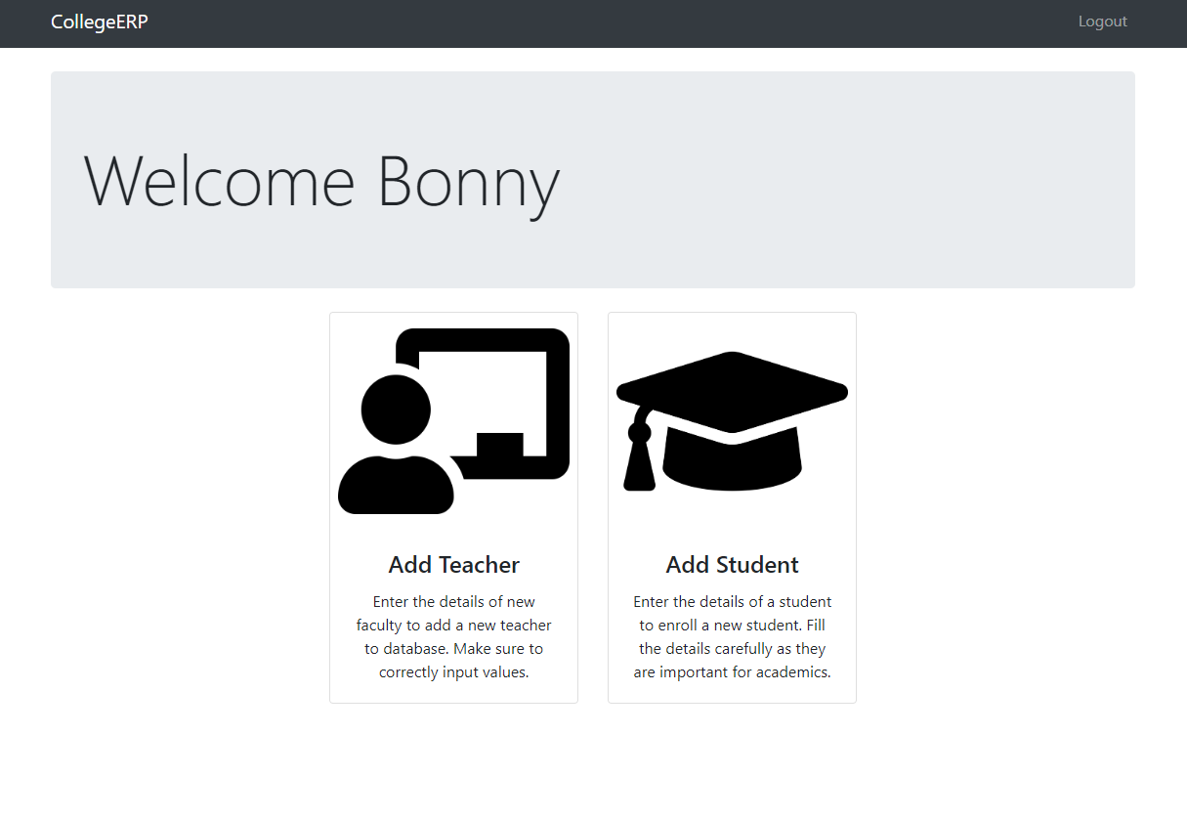
EduSync Pro
AKGEC CollegeERP

Slide 11
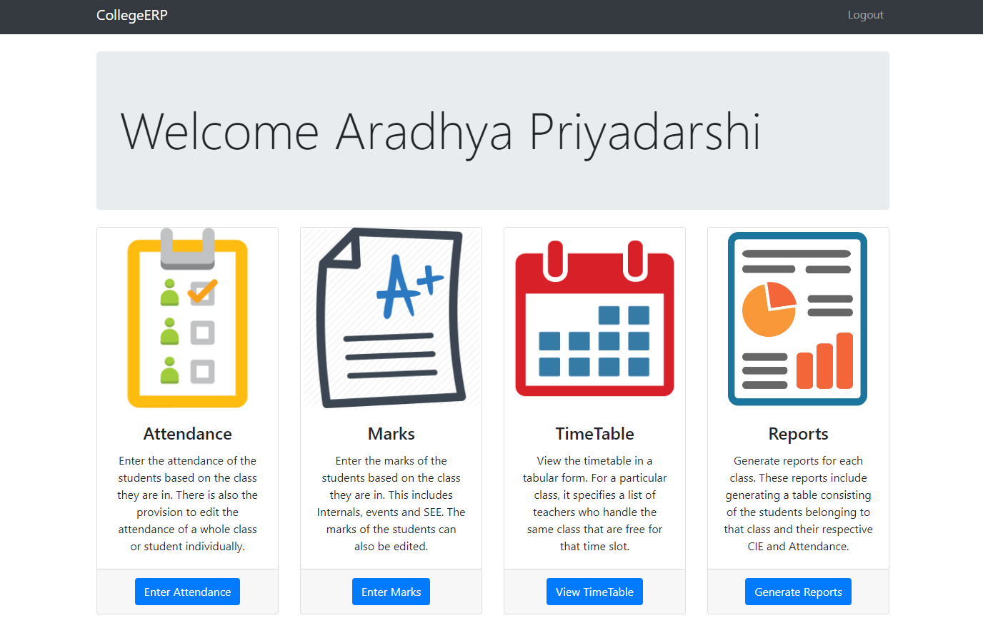

Slide 12
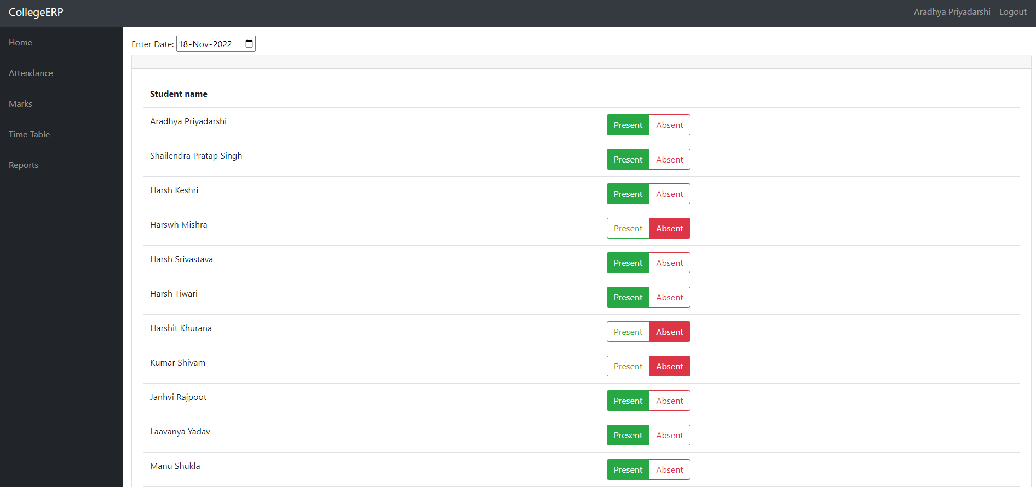

Slide 13
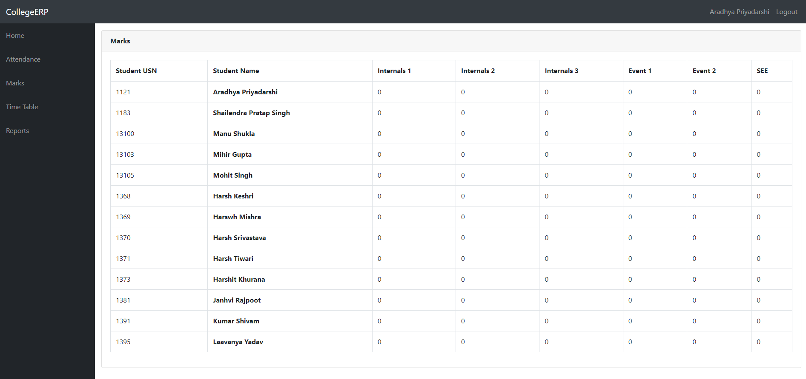

Slide 14
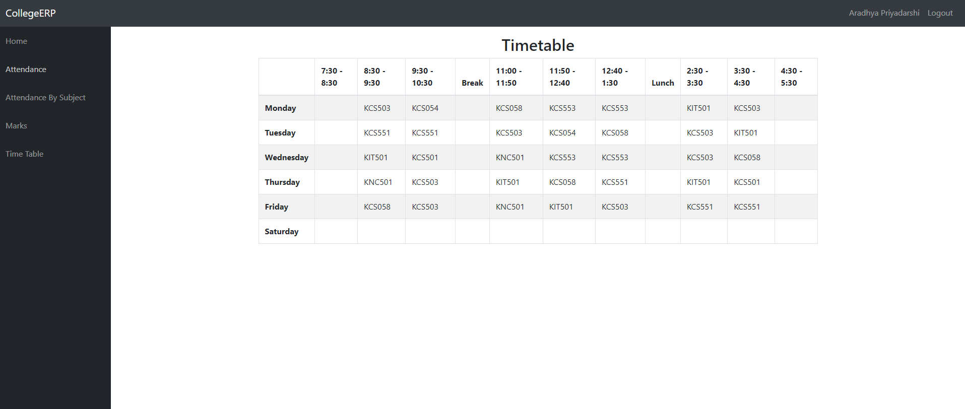

Slide 15
CollegeERP ADMIN Panel

Slide 16
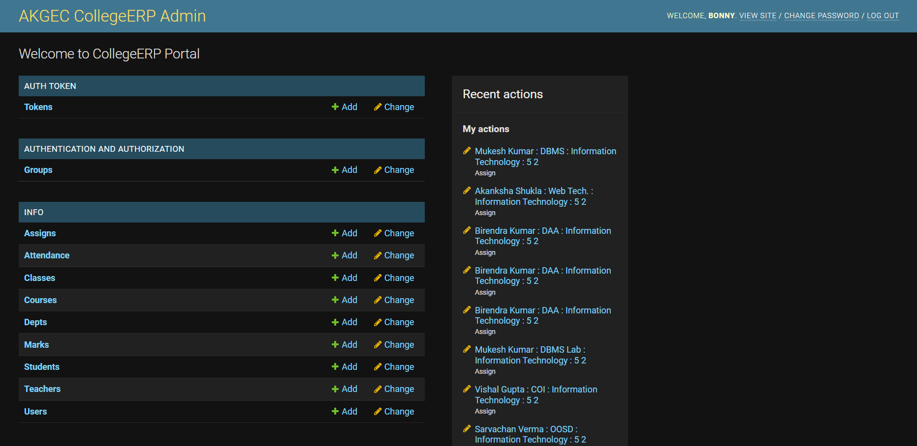

Slide 17
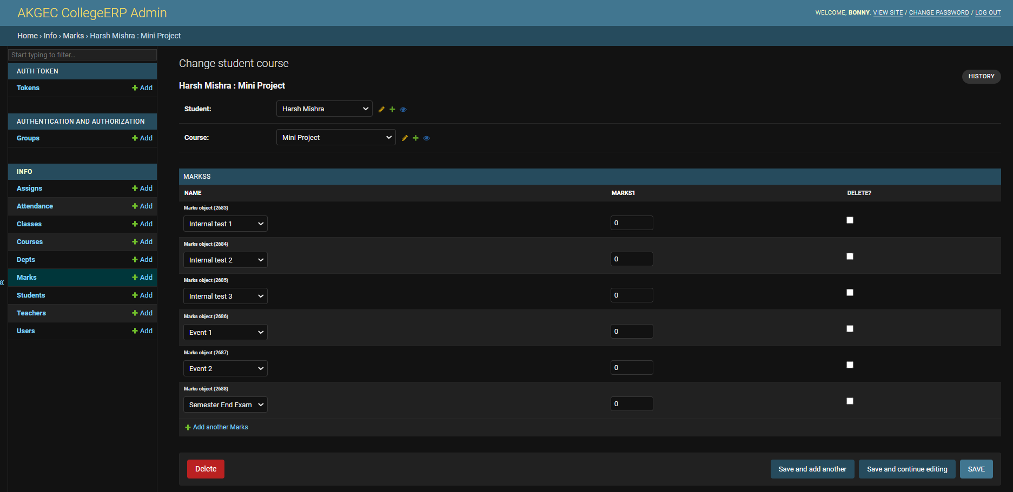

Slide 18

URLs
The EduSync Pro – AKGEC CollegeERP MINI PROJECT is uploaded on the below link. One can have access to it by clicking on this below link:
EduSync Pro – (Frontend) https://edusyncpro.netlify.app/
CollegeERP – (Backend)
https://web-production-853c.up.railway.app/

Slide 19
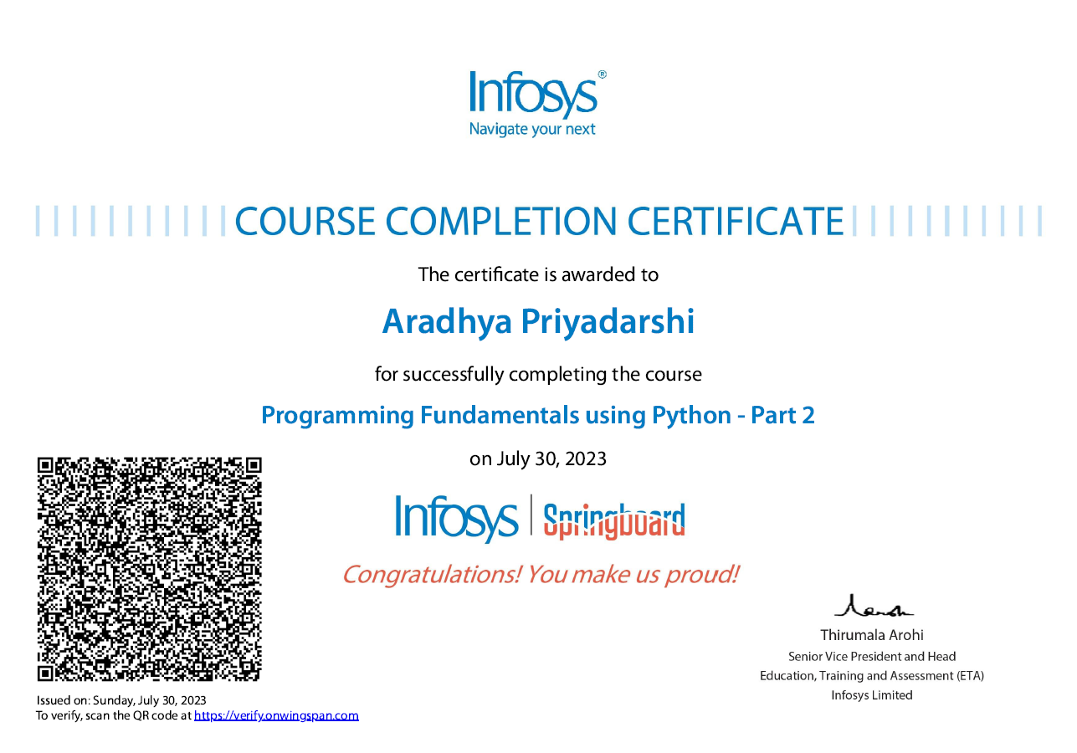

Slide 20
Thank You ☺

